Slide 1
Project Proposal: Modeling Burglaries in Chicago
CDTs Evan Asuncion and Aimee Rohan
v2

Slide 2
Background
Chicago afflicted with high crime rates across the city
Policymakers and law enforcement need to implement well-informed policies/initiatives to confront crime issue
Dataset of 552 distinct Census block groups in Chicago tracking burglary frequency from 2010 to 2015.
Supplementary Data: Adjacency matrix, population stats, unemployment rates, wealth distribution, and count of young males

Slide 3
Problem Statement
Our analysis aims to infer the impact of socio-economic variables on burglary rates in Chicago's Census Block groups, through exploring wealth, unemployment, and population as covariates while also exploring temporal dynamics

Slide 4
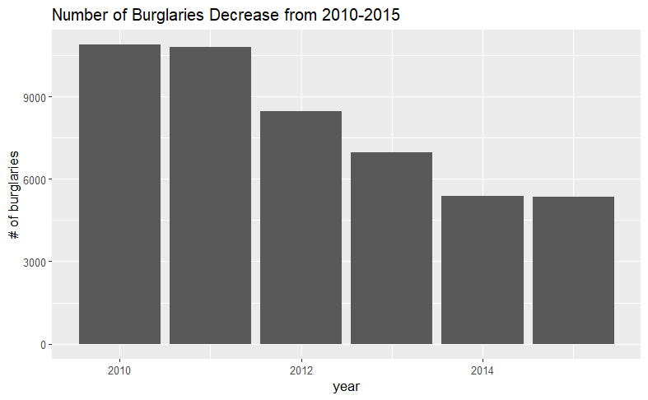
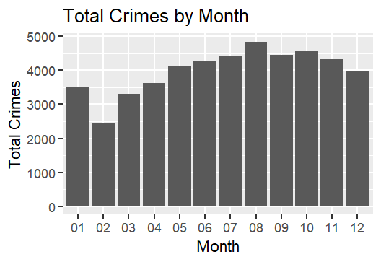
Data Exploration: Temporal Trends
Visual analysis reveals a declining trend in burglary counts over the years.
A declining trend in burglary counts is also noted visually across the colder months
Notes:
Honestly I think this should capture big picture things we got out of this. Like was there positive associations we saw visually ? Collinearity? Initial Data Exploration (Plots shown and explained clearly linking exploration to selected models) - 10 pts

Slide 5
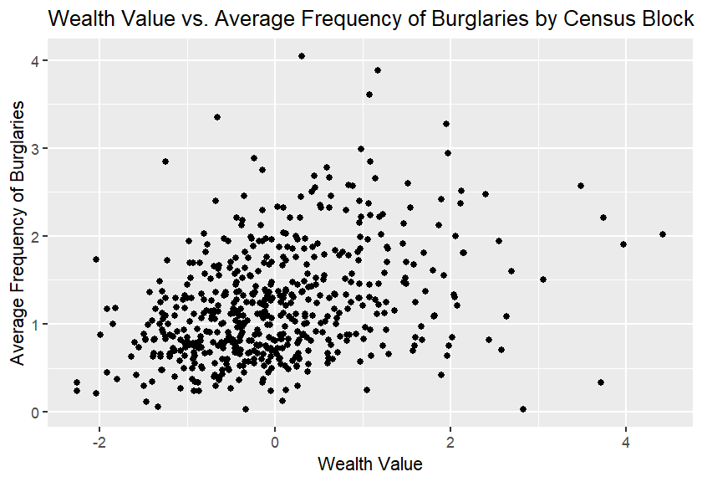
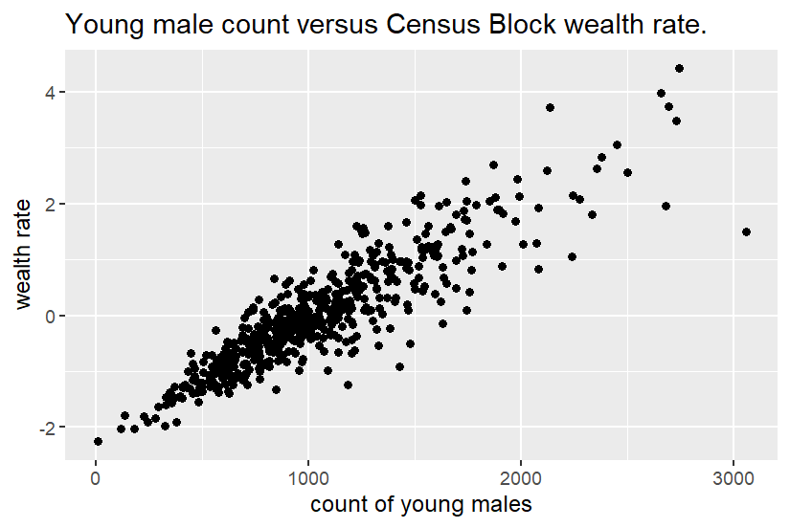
Analyzing Wealth
A Positive trend observed: Higher wealth ratings in census blocks correspond to increased average burglary counts.
Possible Multicollinearity due to strong visual relationship between wealth and count of young men per census block
Notes:
Honestly I think this should capture big picture things we got out of this. Like was there positive associations we saw visually ? Collinearity? Initial Data Exploration (Plots shown and explained clearly linking exploration to selected models) - 10 pts

Slide 6
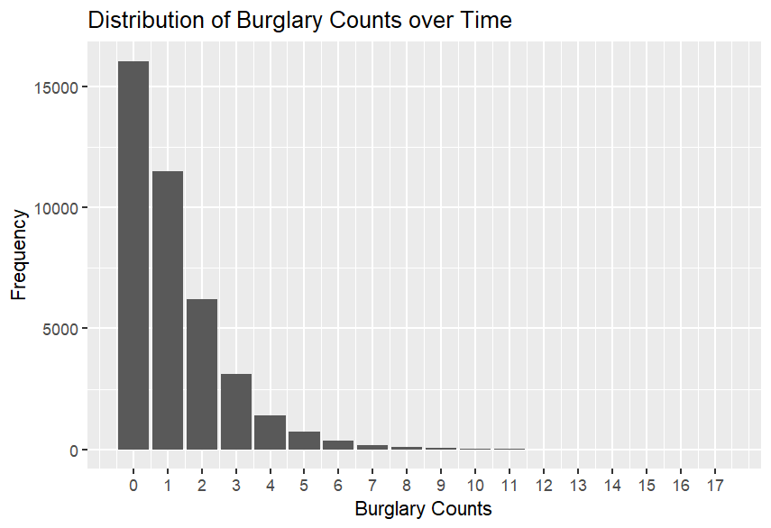
Distribution of Burglary counts
Graphing the reported distribution of burglary counts indicate reported count to predominantly be 0 occurrences, while also declining as counts increase.
Notes:
Honestly I think this should capture big picture things we got out of this. Like was there positive associations we saw visually ? Collinearity? Initial Data Exploration (Plots shown and explained clearly linking exploration to selected models) - 10 pts

Slide 7
Sources of Variation
Observed Variation in: # of burglaries | Sources of Explained variation | Sources of unexplained variation
Inclusion Criteria: Census blocks in Chicago from 2010 to 2015 Design: Observational Study | Wealth, unemployment count of young males, population | Year, month, census block

Slide 8
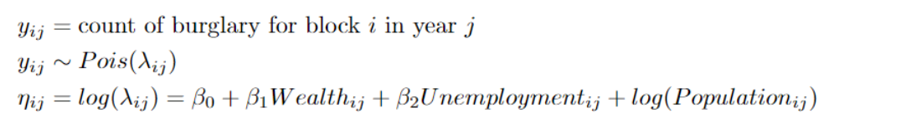
Poisson GLM
Simplest model for count data
Assuming there is not overdispersion in our data
Variable selection resulting from data exploration
Added offset term to account for differences in population density
Notes:
Main thing here is explaining why we chose these models and the assumptions we are making
What col clark wrote: Three proposed models (Written out properly using good statistical notation, all models should be logical and relate to the problem, no 'throw away' models, like the null model, should be considered as part of the three) - 10 pts

Slide 9
ZIP Model
Confronts issue of large number of blocks in given year and month with zero reported burglaries
Choose zip model to explain that possibly there are many zeros due to there being a mechanism of whether one reports or not
Same variable selection process as the initial model
Notes:
Main thing here is explaining why we chose these models and the assumptions we are making
What col clark wrote: Three proposed models (Written out properly using good statistical notation, all models should be logical and relate to the problem, no 'throw away' models, like the null model, should be considered as part of the three) - 10 pts

Slide 10
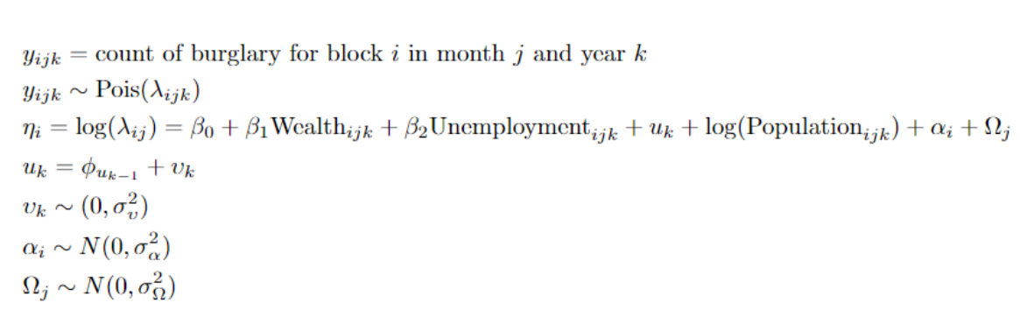
AR-1 Poisson GLMM
Takes into account random effect in different Census block
Considers both month and year
AR-1 structure on year assumes some years that are closer together have a stronger relationship than years further apart
Notes:
Main thing here is explaining why we chose these models and the assumptions we are making
What col clark wrote: Three proposed models (Written out properly using good statistical notation, all models should be logical and relate to the problem, no 'throw away' models, like the null model, should be considered as part of the three) - 10 pts

Slide 11
Questions?

